Slide 1
RFID using Bus Ticketing System
By
Rineesha John
Sreeram SP
Usman
Varun Mahendra

Slide 2
Purpose of This Project
It can be used for transport systems.
This design would help bus drivers in ensuring proper fare collection from their passengers .
The system makes use of low cost RFID reader and cards and tags which are assigned a particular user and payment bundle amount.
All the passenger needs to do is to just swipe his RFID card across the device to pay and gain bus transit access.
For third world countries, this would save the passengers a lot of hassle and stress.

Slide 3
Components Required
Hardware
Software
Arduino Uno
LED
USB Cable
Cross Platform (Windows, Linux, macOS)
Arduino IDE
C/C++ Language

Slide 4
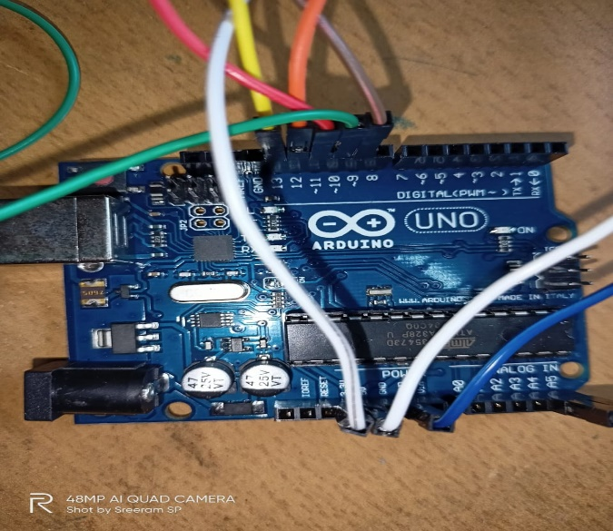
Arduino Uno
The Arduino Uno is an open-source microcontroller board based on the Microchip ATmega328P microcontroller and developed by Arduino.cc. The board is equipped with sets of digital and analog input/output pins that may be interfaced to various expansion boards and other circuits.

Slide 5
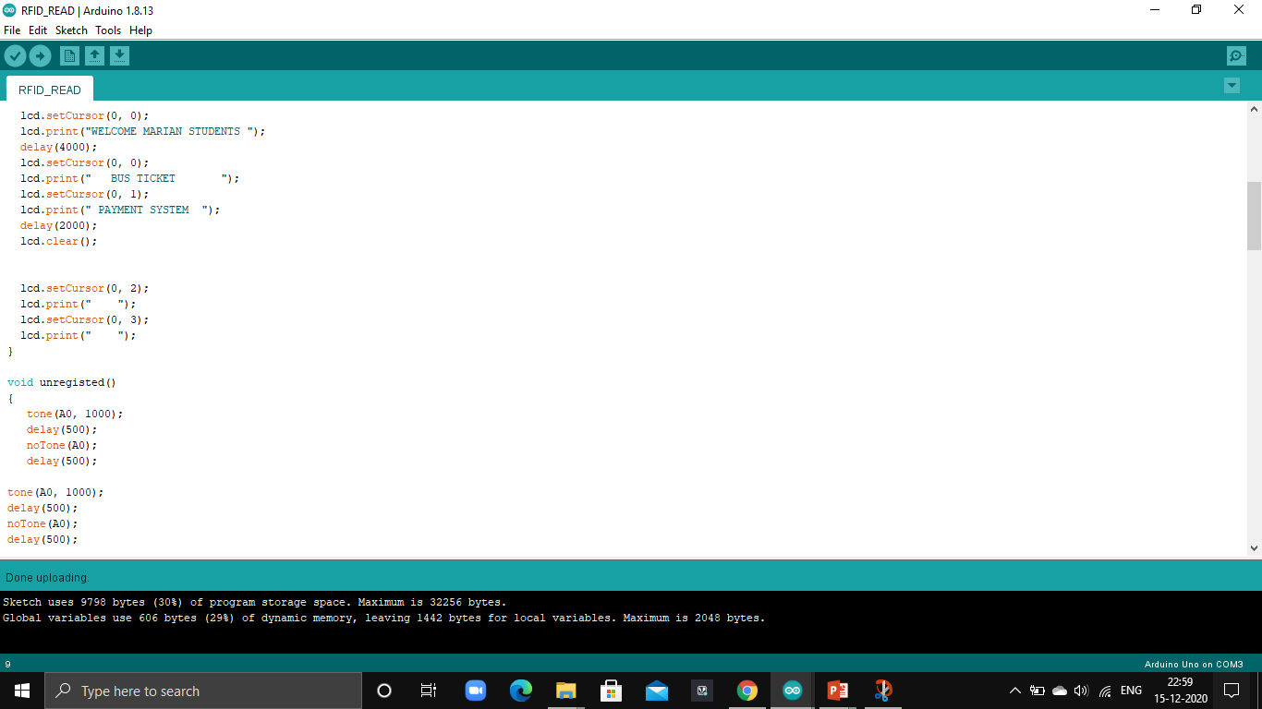
Arduino IDE
The Arduino Integrated Development Environment is a cross platform application that is written in functions from C. It is basically used to write and upload programs to Arduino compatible boards, also with the help of third party cores , other vendor development boards.

Slide 6
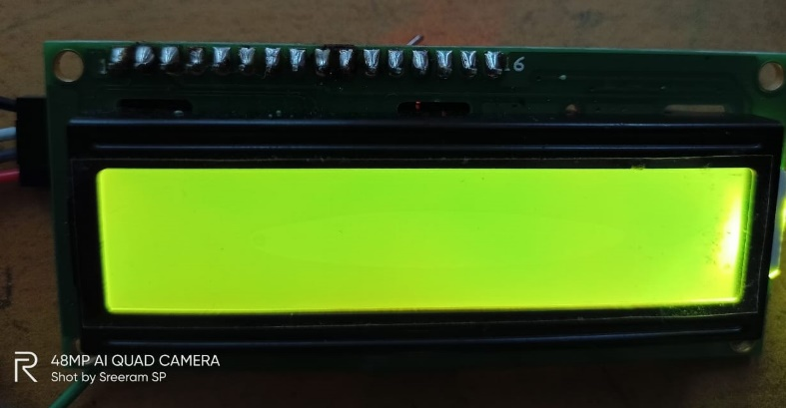
Materials Required
.
LCD Display
Arduino UNO

Slide 7
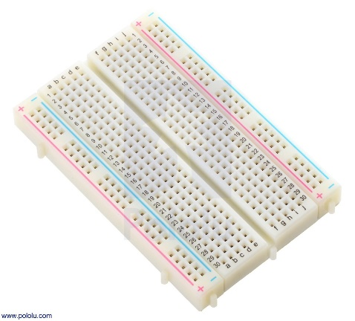
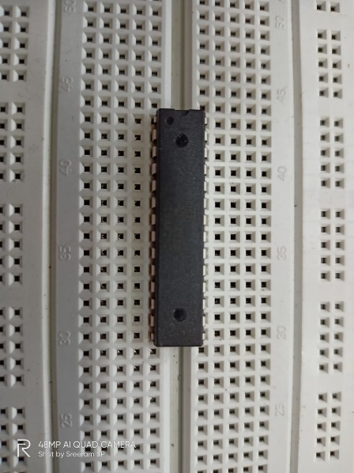
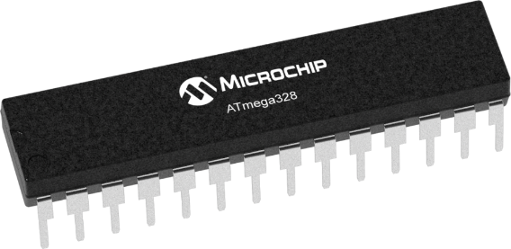
Materials Required
Breadboard
Atmega 328 Microcontrollers

Slide 8
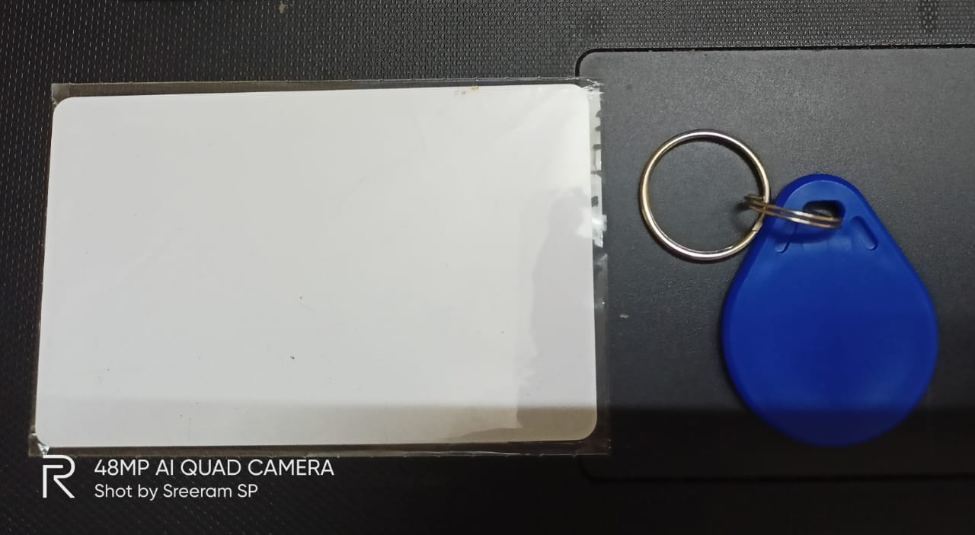
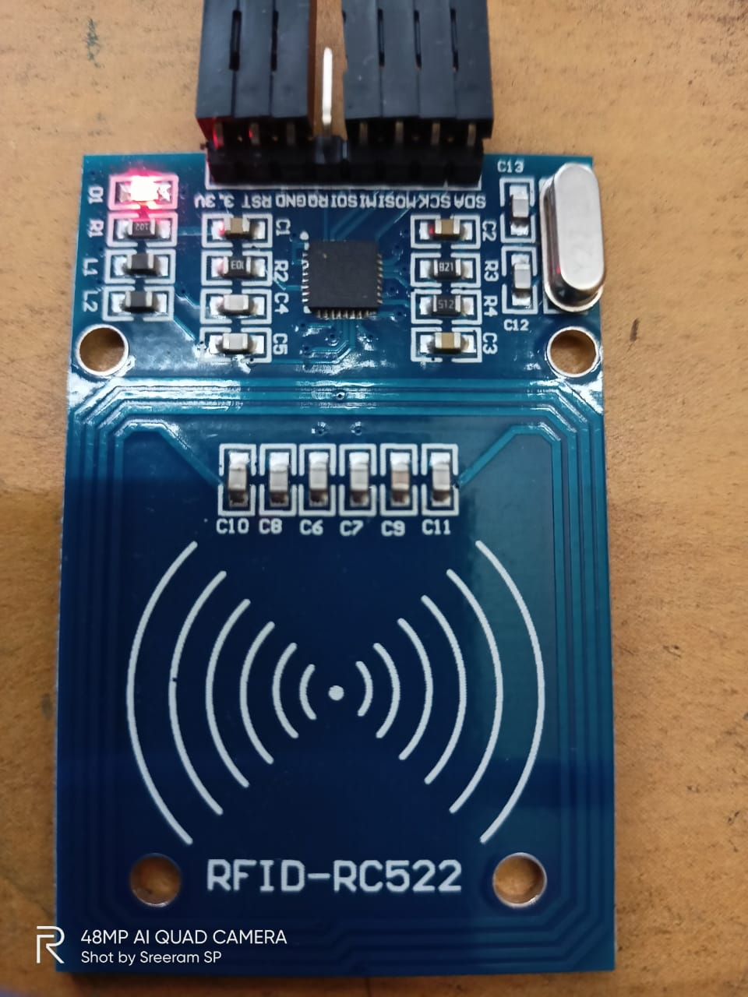
Materials Required
RFID Tags
RFID Reader

Slide 9
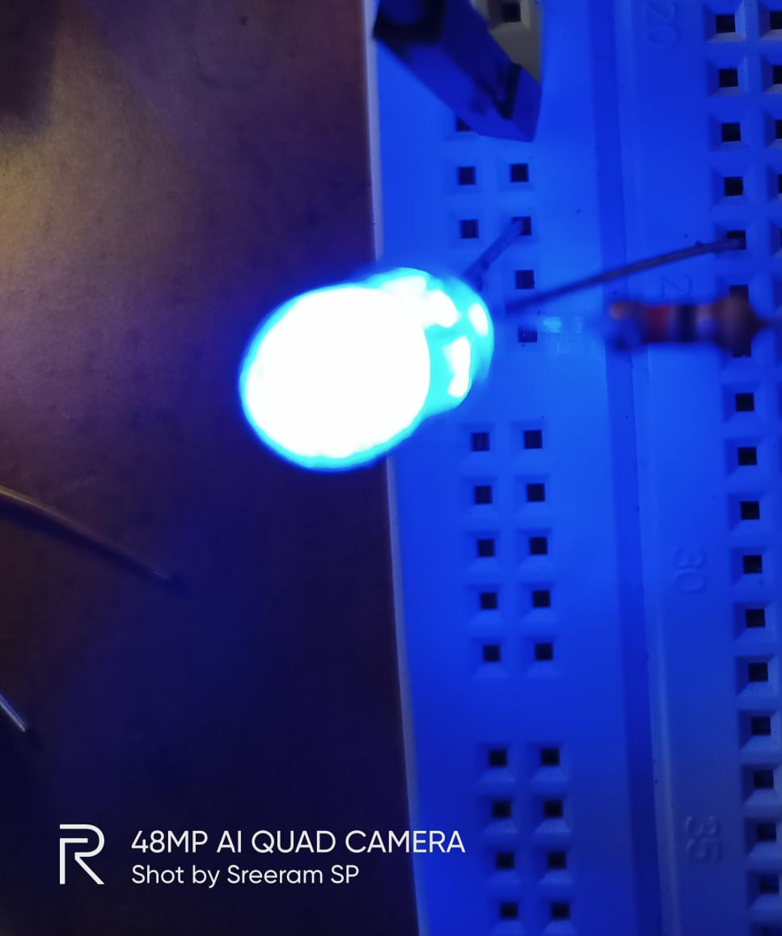
Materials For the Design
Resistors
LEDs
16MHz crystal oscillator
22nF capacitors (2 pieces)
A 10KΩ pull-up resistor
A reset push button.
16 × 2 Liquid Crystal Display
10KΩ potentiometer (trimmer)
56OΩ precision resistor
LCD connector wires’
Header pins

Slide 10
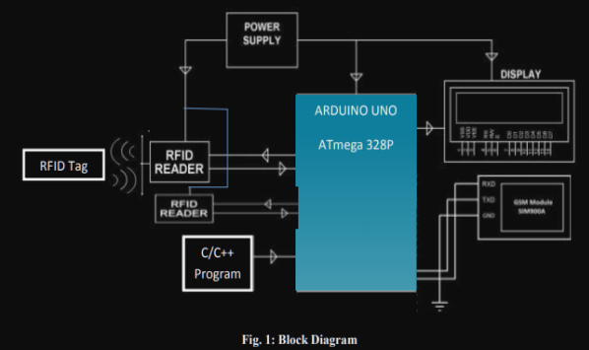
Block Diagram

Slide 11
Working
After the tag is placed before the reader is attached to the bus door, the tag will get important information to the reader on it.
An automatic tag carrier will enter the start location and end location information of the bus through the keypad when bus driver press button.
The reader will accept the card if the card has required credit balance to travel that distance with that amount on it. The data required by the reader will be stored in its first memory .
After the full day, the initial internal memory of the reader will be reset for the next day of the calculation of the fare charges

Slide 12
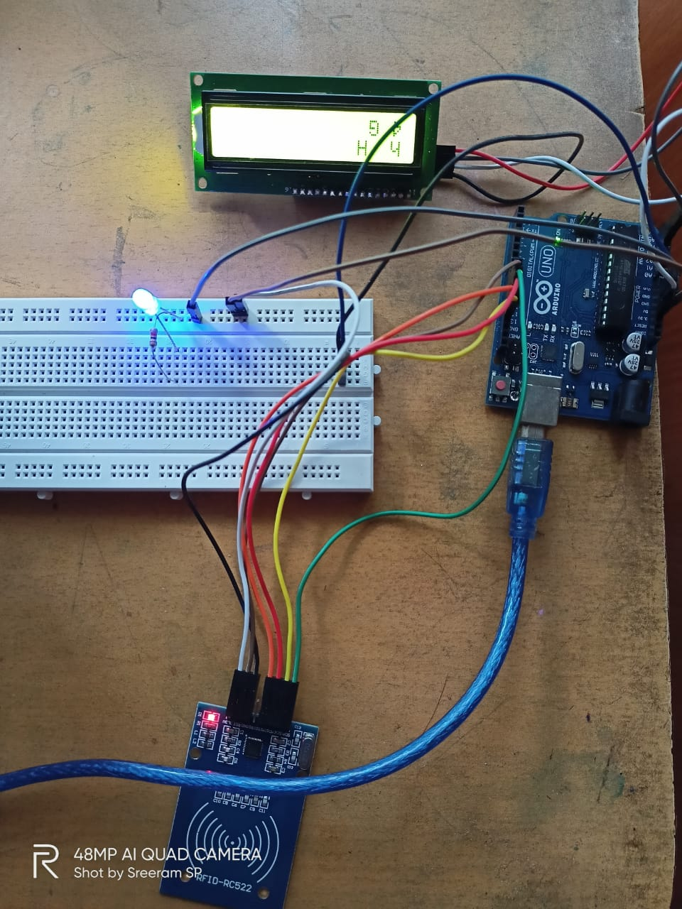
Circuit Diagram

Slide 13
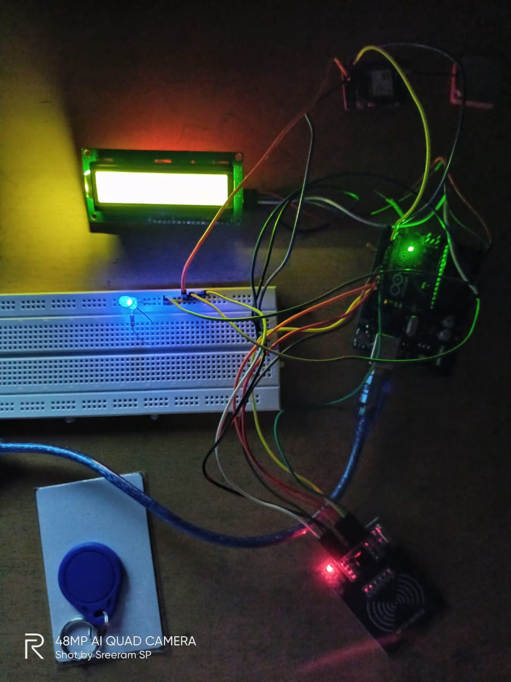
Circuit Diagram

Slide 14
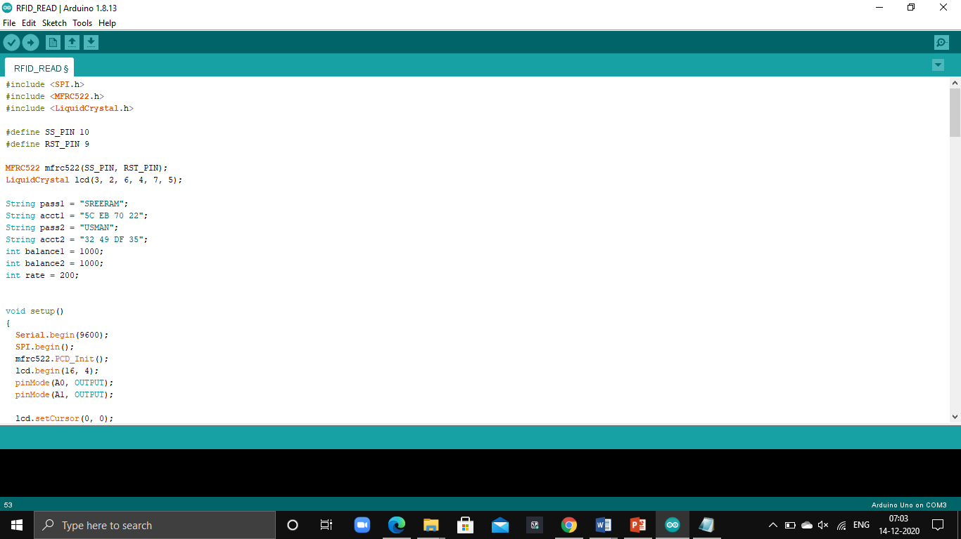
CODE

Slide 15
Advantage
Contactless Payment
Exact Fare Calculation
Environmental Friendly

Slide 16
Conclusion
The system is fully automated, reliable, transparent and convenient. This can also be used in vehicle on highways, their toll payment and in the bus ticketing system with small modifications.
The cards being reusable, they are much more convenient compared to the paper based ticketing system.
The card is to be used as a universal travel pass card that will allow any transportation on any route.

Slide 17
THANK YOU

